Slide 1




SECURE DRIVE: Advanced Vehicle Safety and Security System
Mohammed Shameem S – 722822106082
Prithickshan S - 722822106112
Rahul V – 722822106116
Rohith A M - 722822106127

Slide 2
INTRODUCTION
This project focuses on enhancing vehicle security and safety through a multifaceted authentication system. Utilizing an Arduino microcontroller, the system detects alcohol levels using an MQ-3 sensor. If alcohol is detected, the vehicle is disabled and alerts are triggered.
In the absence of alcohol, the system prompts for a PIN via a 3x4 keypad. A correct PIN activates the vehicle, while incorrect entries trigger alerts and disable the vehicle. An LCD display provides real-time feedback throughout the process.

Slide 3
PROBLEM STATEMENT
The rise in incidents of impaired driving and vehicle theft necessitates advanced vehicle security solutions. Current systems often fail to address both issues effectively, leaving vehicles vulnerable.
This project, SECURE DRIVE, aims to develop an integrated safety and security system that uses alcohol detection and PIN-based authentication to prevent unauthorized access and operation by intoxicated individuals, thereby enhancing overall vehicle safety and security.

Slide 4
COMPONENTS USED
Arduino UNO
MQ3 Sensor
LCD 16x2 i2C
LEDs
Keypad 3x4
Motors
L298D Motor Driver
Buzzer
Push Button

Slide 5
PROJECT DESCRIPTION
Advanced Vehicle Safety and Security System is an innovative project designed to enhance vehicle security and safety through a multi-faceted authentication process.
The system employs an Arduino microcontroller to integrate various components:
Alcohol Detection
PIN-Based Authentication
Real-Time Feedback

Slide 6
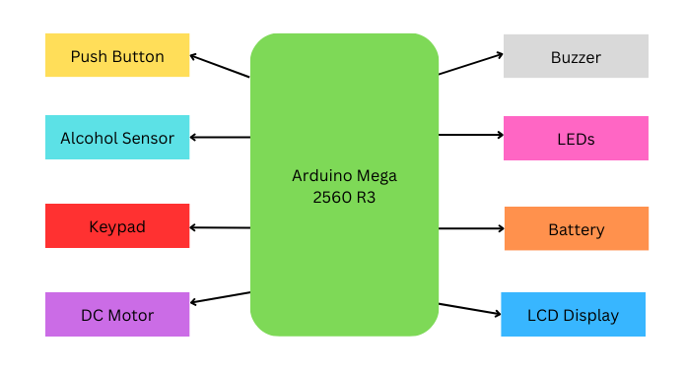
BLOCK DIAGRAM

Slide 7
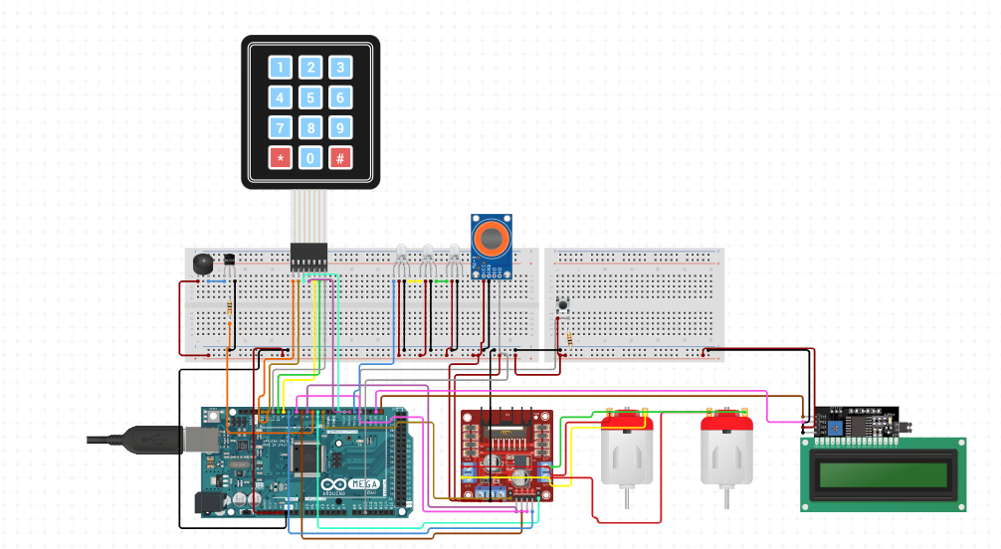
CIRCUIT DIAGRAM

Slide 8
PROJECT IMPORTANCE & BENEFITS
Enhancement of Road Safety
Prevention of Unauthorized Vehicle Use
Promoting Responsible Driving Behavior
Promoting Public Health
Reducing Economic Losses
Theft Prevention

Slide 9
FUTURE ENHANCEMENT
Biometric Authentication
GPS Tracking
Cloud Connectivity
Smartphone Integration
Emergency Response Integration
Environmental Sensors

Slide 10
THANK YOU

